Slide 1
EPICS and Java
Michael Dorin
Michael.dorin@metrostate.edu
Metropolitan State University
St. Paul, MN.

Slide 2
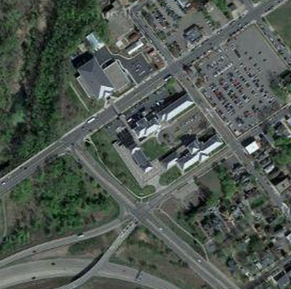
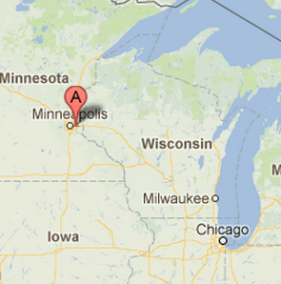
Metropolitan State University

Slide 3
Inspiration
We have both undergraduate and graduate computer science students
Computer Science in the 80’s (and before) was tied to math and engineering
Now it is tied to the web and business

Slide 4
Computer Science
Metro State’s teaching language is Java
Virtual Linac bootable image on Ubuntu 12.04
Starting this teaching experiment in 2 weeks
Sophomore level design class
My class goal: A ‘Cool’ GUI for the Virual Linac

Slide 5
JCA
It seemed natural to start here:http://www.aps.anl.gov/bcda/jca/jca/
It has a JNI component and the available dll was 32 bits
64-bit java required a 64 bit dll

Slide 6
Challenge: VS 2012
Visual Studio 2012 Express
No cost and easily attainable
Tools for generating x64 binaries don’t always install
‘Repair’ the visual studio installation
I don’t know why, but this seems to work

Slide 7
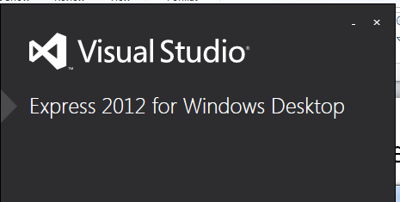
If you don’t get 64 bit
Control Panel, Programs, “Repair”
64-bit tools will be installed during repair

Slide 8
Now build EPICS Base
Create a Win64.bat
Not very different from win32.bat
substitute vcvarsall.bat with x86_amd64\vcvarsx86_amd64.bat
set EPICS_HOST_ARCH=windows-x64
Setup Perl if you need to
Setup path to gnu make if you need to
Build via the “VS2012 x64 Cross Tools Command Prompt”
Go get a coffee

Slide 9
Continuing to JCA
Get ‘ant’ and JCA Source
Within JCA source tree
config.windows-x64.properties
config.properties
build.windows-x64.properties
Edit build.xml
Edit Jni.cpp and add #include <cstdlib>

Slide 10
Build JCA
run ‘ant’
Seems easy enough now…

Slide 11
Process too challenging
Thank you Matej Sekoranja for information on CAJ and examples
I should have asked earlier!

Slide 12
CAJ
SURPRISE!!! NO NEED for JCA’s .DLL
You still need jca.jar
http://epics.sourceforge.net/maven2/epics/jca/
You need a caj jar
http://epics.sourceforge.net/maven2/epics/caj/
Download, simply add to your eclipse project
Mercurial ‘plugin’ for eclipse might help too!
For desktop apps, you are in business.

Slide 13
What about Android?
Very easy
Download android sdk
http://developer.android.com/sdk/index.html
Download JCA source and CAJ sources

Slide 14
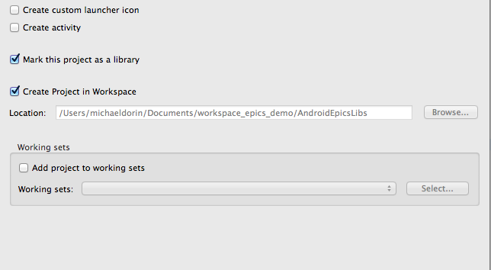
Create a Android Library Project

Slide 15
Import the libraries
I downloaded
caj-1.1.11-20121223.123632-9-sources.jar
jca-2.3.6-sources-a.jar
Extract jar files
jar -xvf jca-2.3.6-sources-a.jar
Jar –xvf caj-1.1.11-20121223.123632-9-sources.jar
Re-zip
zip -r caj.zip *

Slide 16
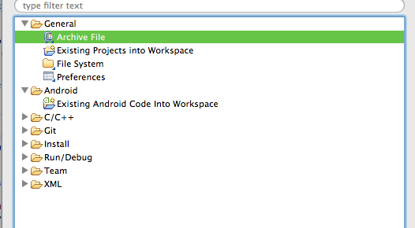
Import into eclipse

Slide 17
Android Pitfalls
Android UI thread wants everything run to completion
“When the thread is blocked, no events can be dispatched, including drawing events.”

Slide 18
Android Pitfalls
Permissions
<uses-permission android:name="android.permission.INTERNET" />
Threads
http://developer.android.com/guide/components/processes-and-threads.html
Android activity lifecycle http://developer.android.com/reference/android/app/Activity.html

Slide 19
Conclusion
Ready, but more work to do
After GUI work, inspire student created simulations
More work needed on mobile devices
Android NDK gives a gnu ‘c’ compiler easily
IOS is happy(ish) with ‘c’ programs
Michael.Dorin@metrostate.edu
http://www.datometer.com/dorin

Slide 20
Thank you!
Michael.Dorin@metrostate.edu
http://www.datometer.com/dorin

